Slide 1
Chapter 1: Introduction

Slide 2
Chapter 1: Introduction
What Operating Systems Do
Computer-System Organization
Computer-System Architecture
Operating-System Structure
Operating-System Operations
Kernel Data Structures
Computing Environments
Open-Source Operating Systems

Slide 3
Objectives
To describe the basic organization of computer systems
To provide a grand tour of the major components of operating systems
To give an overview of the many types of computing environments
To explore several open-source operating systems

Slide 4
What is an Operating System?
A program that acts as an intermediary between a user of a computer and the computer hardware
Operating system goals:
  Execute user programs and make solving user problems easier
  Make the computer system convenient to use
  Use the computer hardware in an efficient manner

Slide 5
Computer System Structure
Computer system can be divided into four components:
  Hardware – provides basic computing resources
    CPU, memory, I/O devices
  Operating system
    Controls and coordinates use of hardware among various applications and users
  Application programs – define the ways in which the system resources are used to solve the computing problems of the users
    Word processors, compilers, web browsers, database systems, video games
  Users
    People, machines, other computers

Slide 6

Four Components of a Computer System

Slide 7
What Operating Systems Do
Depends on the point of view
Users want convenience, ease of use
  Don’t care about resource utilization
But shared computer such as mainframe or minicomputer must keep all users happy
Users of dedicate systems such as workstations have dedicated resources but frequently use shared resources from servers
Handheld computers are resource poor, optimized for usability and battery life
Some computers have little or no user interface, such as embedded computers in devices and automobiles

Slide 8
Operating System Definition
OS is a resource allocator
  Manages all resources
  Decides between conflicting requests for efficient and fair resource use
OS is a control program
  Controls execution of programs to prevent errors and improper use of the computer

Slide 9
Operating System Definition (Cont.)
No universally accepted definition
“Everything a vendor ships when you order an operating system” is good approximation
  But varies wildly
“The one program running at all times on the computer” is the kernel. Everything else is either a system program (ships with the operating system) or an application program.

Slide 10
Computer Startup
bootstrap program is loaded at power-up or reboot
  Typically stored in ROM or EPROM, generally known as firmware
  Initializes all aspects of system
  Loads operating system kernel and starts execution

Slide 11

Computer System Organization
Computer-system operation
  One or more CPUs, device controllers connect through common bus providing access to shared memory
  Concurrent execution of CPUs and devices competing for memory cycles

Slide 12
Computer-System Operation
I/O devices and the CPU can execute concurrently
Each device controller is in charge of a particular device type
Each device controller has a local buffer
CPU moves data from/to main memory to/from local buffers
I/O is from the device to local buffer of controller
Device controller informs CPU that it has finished its operation by causing an interrupt

Slide 13
Operating System Structure
Multiprogramming needed for efficiency
  Single user cannot keep CPU and I/O devices busy at all times
  Multiprogramming organizes jobs (code and data) so CPU always has one to execute
  A subset of total jobs in system is kept in memory
  One job selected and run via job scheduling
  When it has to wait (for I/O for example), OS switches to another job
Timesharing (multitasking) is logical extension in which CPU switches jobs so frequently that users can interact with each job while it is running, creating interactive computing
  Response time should be < 1 second
  Each user has at least one program executing in memory process
  If several jobs ready to run at the same time  CPU scheduling
  If processes don’t fit in memory, swapping moves them in and out to run
  Virtual memory allows execution of processes not completely in memory

Slide 14

Memory Layout for Multiprogrammed System

Slide 15
Operating-System Operations
Interrupt driven by hardware
Software error or request creates exception or trap
  Division by zero, request for operating system service
Other process problems include infinite loop, processes modifying each other or the operating system
Dual-mode operation allows OS to protect itself and other system components
  User mode and kernel mode
  Mode bit provided by hardware
    Provides ability to distinguish when system is running user code or kernel code
    Some instructions designated as privileged, only executable in kernel mode
    System call changes mode to kernel, return from call resets it to user
Increasingly CPUs support multi-mode operations
  i.e. virtual machine manager (VMM) mode for guest VMs

Slide 16

Transition from User to Kernel Mode
Timer to prevent infinite loop / process hogging resources
  Set interrupt after specific period
  Operating system decrements counter
  When counter zero generate an interrupt
  Set up before scheduling process to regain control or terminate program that exceeds allotted time

Slide 17



Kernel Data Structures
Many similar to standard programming data structures
Singly linked list
Doubly linked list
Circular linked list

Slide 18
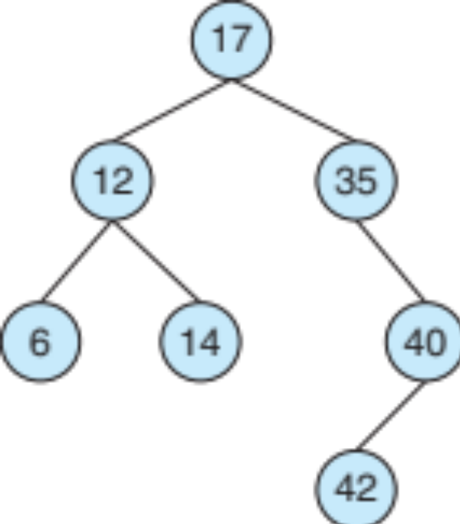
Kernel Data Structures
Binary search tree
left <= right
  Search performance is O(n)
  Balanced binary search tree is O(lg n)

Slide 19

Kernel Data Structures
Hash function can create a hash map
Bitmap – string of n binary digits representing the status of n items
Linux data structures defined in include files <linux/list.h>, <linux/kfifo.h>, <linux/rbtree.h>

Slide 20
Computing Environments - Traditional
Stand-alone general purpose machines
But blurred as most systems interconnect with others (i.e. the Internet)
Portals provide web access to internal systems
Network computers (thin clients) are like Web terminals
Mobile computers interconnect via wireless networks
Networking becoming ubiquitous – even home systems use firewalls to protect home computers from Internet attacks

Slide 21
Computing Environments - Mobile
Handheld smartphones, tablets, etc
What is the functional difference between them and a “traditional” laptop?
Extra feature – more OS features (GPS, gyroscope)
Allows new types of apps like augmented reality
Use IEEE 802.11 wireless, or cellular data networks for connectivity
Leaders are Apple iOS and Google Android

Slide 22
Computing Environments – Distributed
Distributed
  Collection of separate, possibly heterogeneous, systems networked together
    Network is a communications path, TCP/IP most common
      Local Area Network (LAN)
      Wide Area Network (WAN)
      Metropolitan Area Network (MAN)
      Personal Area Network (PAN)
  Network Operating System provides features between systems across network
    Communication scheme allows systems to exchange messages
    Illusion of a single system

Slide 23

Computing Environments – Client-Server
Client-Server Computing
  Dumb terminals supplanted by smart PCs
  Many systems now servers, responding to requests generated by clients
    Compute-server system provides an interface to client to request services (i.e., database)
    File-server system provides interface for clients to store and retrieve files

Slide 24

Computing Environments - Peer-to-Peer
Another model of distributed system
P2P does not distinguish clients and servers
  Instead all nodes are considered peers
  May each act as client, server or both
  Node must join P2P network
    Registers its service with central lookup service on network, or
    Broadcast request for service and respond to requests for service via discovery protocol
  Examples include Napster and Gnutella, Voice over IP (VoIP) such as Skype

Slide 25
Computing Environments - Virtualization
Allows operating systems to run applications within other OSes
  Vast and growing industry
Emulation used when source CPU type different from target type (i.e. PowerPC to Intel x86)
  Generally slowest method
  When computer language not compiled to native code – Interpretation
Virtualization – OS natively compiled for CPU, running guest OSes also natively compiled
  Consider VMware running WinXP guests, each running applications, all on native WinXP host OS
  VMM provides virtualization services

Slide 26
Computing Environments - Virtualization
Use cases involve laptops and desktops running multiple OSes for exploration or compatibility
  Apple laptop running Mac OS X host, Windows as a guest
  Developing apps for multiple OSes without having multiple systems
  QA testing applications without having multiple systems
  Executing and managing compute environments within data centers
VMM can run natively, in which case they are also the host
  There is no general purpose host then (VMware ESX and Citrix XenServer)

Slide 27

Computing Environments - Virtualization

Slide 28
Computing Environments – Cloud Computing
Delivers computing, storage, even apps as a service across a network
Logical extension of virtualization as based on virtualization
  Amazon EC2 has thousands of servers, millions of VMs, PBs of storage available across the Internet, pay based on usage
Many types
  Public cloud – available via Internet to anyone willing to pay
  Private cloud – run by a company for the company’s own use
  Hybrid cloud – includes both public and private cloud components
  Software as a Service (SaaS) – one or more applications available via the Internet (i.e. word processor)
  Platform as a Service (PaaS) – software stack ready for application use via the Internet (i.e a database server)
  Infrastructure as a Service (IaaS) – servers or storage available over Internet (i.e. storage available for backup use)

Slide 29

Computing Environments – Cloud Computing
Cloud compute environments composed of traditional OSes, plus VMMs, plus cloud management tools
  Internet connectivity requires security like firewalls
  Load balancers spread traffic across multiple applications

Slide 30
Computing Environments – Real-Time Embedded Systems
Real-time embedded systems most prevalent form of computers
  Vary considerable, special purpose, limited purpose OS, real-time OS
  Use expanding
Many other special computing environments as well
  Some have OSes, some perform tasks without an OS
Real-time OS has well-defined fixed time constraints
  Processing must be done within constraint
  Correct operation only if constraints met

Slide 31
Open-Source Operating Systems
Operating systems made available in source-code format rather than just binary closed-source
Counter to the copy protection and Digital Rights Management (DRM) movement
Started by Free Software Foundation (FSF), which has “copyleft” GNU Public License (GPL)
Examples include GNU/Linux and BSD UNIX (including core of Mac OS X), and many more
Can use VMM like VMware Player (Free on Windows), Virtualbox (open source and free on many platforms - http://www.virtualbox.com)
  Use to run guest operating systems for exploration

